Slide 1
Introduction to Information Systems
HTM 304 - Management Information Systems
College of Business Administration
California State University @ San Marcos
Authors: Turban, Rainer and Potter
Publisher: John Wiley & Sons, Inc.

Slide 2
Chapter 2
The Modern Organization in the Digital Economy

Slide 3
Chapter Outline
2.1 Doing Business in the Digital Economy
2.2 Business Pressures, Organizational Responses, and IT Support
2.3 Competitive Advantage and Strategic Information Systems
2.4 Why Should You Learn about Information Technology?

Slide 4
Learning Objectives
Describe the characteristics of the digital economy and e-business.
Discuss the relationships among business pressures, organizational responses and information systems.
Describe strategic information systems (SISs) and explain their advantages.

Slide 5
Learning Objectives (Continued)
Describe Porter’s competitive force model and how information technology helps companies improve their competitive positions.
Describe five strategies that companies can use to achieve competitive advantage in their industries.

Slide 6
2.1 Doing Business in the Digital Economy
The digital economy is an economy based on digital technologies, including communication networks (the Internet, intranets, and extranets), computers, software, and other related technologies.
Also called the Internet economy, the new economy, or the Web economy .
Digital infrastructures provide a global platform over which people and organizations interact, communicate, collaborate, and search for information.

Slide 7
The Global Platform of the New Economy
A huge number of digitizable products; that is products that can be converted to digital format. Most common are: books, movies, magazines, TV and radio programming, electronic games, music CDs and computer software.
Consumers and firm conducting financial transaction digitally.
Physical goods such as home appliances and automobiles that contain embedded computer chips and connectivity capabilities.

Slide 8
Electronic Business
Businesses increasingly perform their basic functions: buying and selling goods and services, servicing customers, and collaborating with business partners electronically.
This process is known as electronic business (E-business) or electronic commerce (E-commerce).

Slide 9
New Economy vs. Old Economy
Example | Old | New
Buying and selling text book | Visit the bookstore | Visit web site for publishers and retailers
Registering for classes | Walk around campus to Departments, Registrar’s office, etc. | Access campus web site
Photography | Buy film, use camera, take picture, take it for processing | Use digital camera
Paying for Gasoline | Fill up your car, go inside, pay cash or credit card | Use speed pass token wave over the sensor and go
Paying the Transportation | Pay cash, metal tokens | Metro cards electronic cards
Paying for goods | Visit store, take the item, pay , go | Use self – service kiosks
Supplying commercial photos | Use newspapers, paper, catalog or on line | Use hub-like supply chain with digitized picture

Slide 10
New Economy vs. Old Economy
Example #1: Registering for Classes
Old Economy: You would go to the Registrar’s Office on campus with a paper registration document.
New Economy: You access your campus Web site, log into registration site, and electronically register for classes from anywhere.

Slide 11
New Economy vs. Old Economy
Example #2: Buying and Selling Textbooks
Old Economy: You go to the bookstore in person and buy new or sell used books.
New Economy: You go online to the Publisher’s Web site or to Web-based services such as Amazon.com to buy or sell books.

Slide 12
New Economy vs. Old Economy
Example #3: Photography
Old Economy: You use a camera with film, which you have to purchase and have developed; you mail copies of pictures.
New Economy: You can scan photos, make copies and e-mail them. Digital cameras require no film or processing. Digital photography and video integrated into cell phones for immediate viewing.

Slide 13
New Economy vs. Old Economy
Example #4: Paying for Gasoline
Old Economy: You pump your gas and go inside to pay using cash or credit.
New Economy: Insert credit card at pump, receive authorization, pump gas, receive receipt, drive away. Another example is Speedpass technology.

Slide 14
New Economy vs. Old Economy
Example #5: Paying for Transportation in New York City
Old Economy: Using tokens for bus and subway transportation.
New Economy: Bus and subway riders now use MetroCards, contactless cards that have a small radio transmitter that transmit account information to a reader.

Slide 15
New Economy vs. Old Economy
Example #6: Paying for Goods, Checkout
Old-old Economy: Customer selects goods, waits in line for the cashier to key in price of items, and then pays in cash.
Old Economy: The clerk swipes the barcode of each item and customer pays in cash, credit, debit. Information scanned is available for immediate analysis known as source-data automation.

Slide 16
New Economy vs. Old Economy (Ex. #6 Continued)
Old Economy: Shoppers take their items to a self-service kiosk and swipe the barcodes themselves.
New Economy: Wireless technology affixed to each item allows you to select items that pass through a scanner that reads wireless signals, generates a bill, automatically debits your designated account for payment and you leave.

Slide 17
2.2 Business Pressures, Organizational Responses, and IT Support
Business Pressure - The business environment is the combination of social, legal, economic, physical, and political factors that affect business activities.
Significant changes in any of these factor are likely to create business pressure on the organization.
The three types of business pressures faced are: market, technology, and societal pressures.

Slide 18
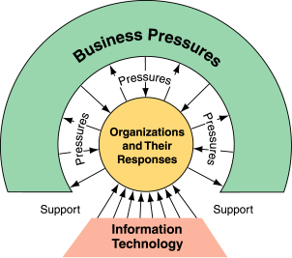
IT Support for Organizational Responses to Business Pressures

Slide 19
Three Types of Business Pressures
Market Pressures:
  The Global Economy and Strong Competition
  The Changing Nature of the Workforce
  Powerful Customers

Slide 20
Business Pressures (Continued)
Technology Pressures:
  Technological Innovation and Obsolescence
  Information Overload

Slide 21
Business Pressures (Continued)
Societal Pressures:
  Social Responsibility
  Government Regulation and Deregulation
  Protection Against Terrorist Attacks.
  Ethical Issues

Slide 22
Organizational Responses
Strategic Systems provide advantages that enable organizations to increase market share and/or profits, to better negotiate with suppliers, or prevent competitors from entering their markets.
Customer Focus is the difference between attracting and keeping customers by providing superb customer service to losing them to competitors.

Slide 23
Organizational Responses (Continued)
Make-to-Order is a strategy of producing customized products and services.
Mass Customization is producing a large quantity of items, but customizing them to fit the desire of each customer.
E-business and E-commerce is the strategy of doing business electronically.

Slide 24
2.3 Competitive Advantage and Strategic Information Systems
Competitive Advantage: An advantage over competitors in some measure such as cost, quality, or speed, leads to control of a market and to larger- than average profits.
Strategic Information Systems (SIS) provide a competitive advantage by helping an organization to implement its strategic goals and to increase its performance and productivity.

Slide 25
Porter’s Competitive Forces Model
The best-known framework for analyzing competitiveness is Michael Porter’s competitive forces model (Porter, 1985).
Model is used to develop strategies to increase their competitive edge.
Demonstrates how IT can make a company more competitive.

Slide 26
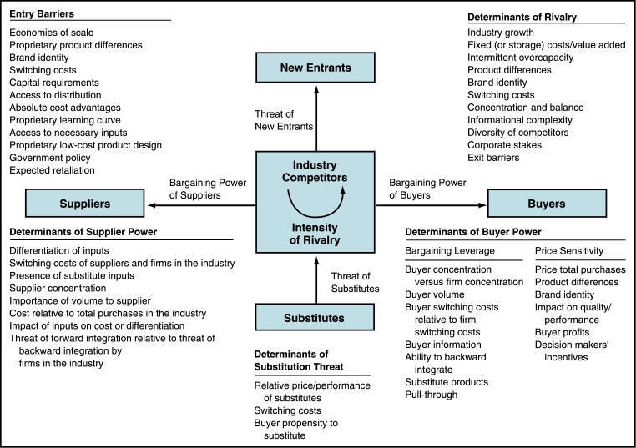
Porter’s Competitive Forces Model

Slide 27
Strategies for Competitive Advantage
Cost Leadership. Produce products and/or services at the lowest cost in the industry.
Differentiation. Offer different products, services or product features.
Innovation. Introduce new products and services, add new features to existing products and services or develop new ways to produce them.

Slide 28
Strategies for Competitive Advantage (Continued)
Operational Effectiveness. Improve the manner in which internal business processes are executed so that a firm performs similar activities better than its rivals.
Customer-orientation. Concentrate on making customers happy.

Slide 29
2.4 Why Should You Learn about Information Technology (IT)?
IT is essential for work in organizations.
IT will reduce the number of middle managers.
IT will change the manager’s job.
IT impacts employees at work.
IT impacts employees’ health and safety.
IT is used by all departments.

Slide 30
Why Should You Learn about IT? (Continued)
IT provides opportunities for people with disabilities.
IT provides quality-of-life improvements.
Improvements in health care.
Crime fighting and other benefits.

